Slide 1

Classifier for the Sarcasm dataset
Notes:
1

Slide 2
Objectives
Process the Sarcasm dataset
Build a classifier for the sarcasm dataset
Classifier for the Sarcasm dataset
2

Slide 3
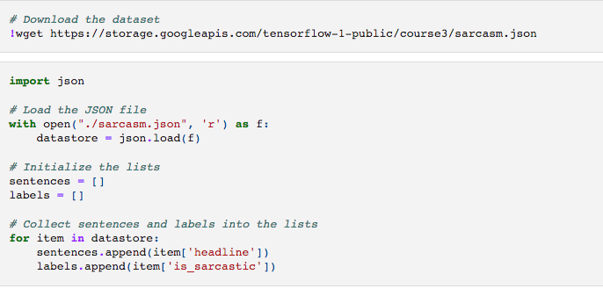
Download the dataset
Augmentation
Classifier for the Sarcasm dataset
3
Notes:
3

Slide 4
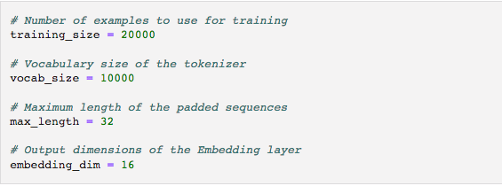
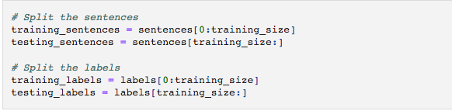
Setup
Hyperparameters
Split the dataset
Classifier for the Sarcasm dataset
4
Notes:
4

Slide 5
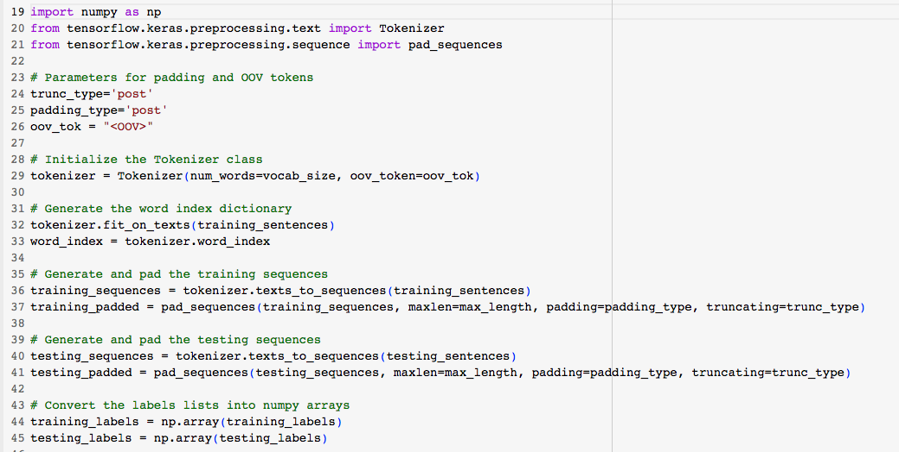
Preprocessing the train and test
Classifier for the Sarcasm dataset
5
Notes:
5

Slide 6
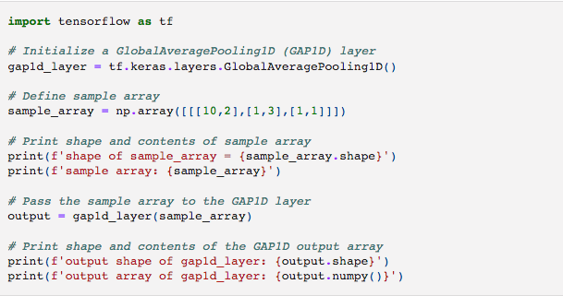
Setup model
Classifier for the Sarcasm dataset
6
Notes:
6

Slide 7
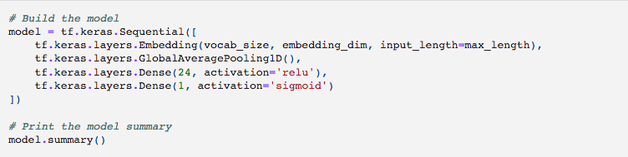
Build, compile and train model
Classifier for the Sarcasm dataset
7
Notes:
7

Slide 8
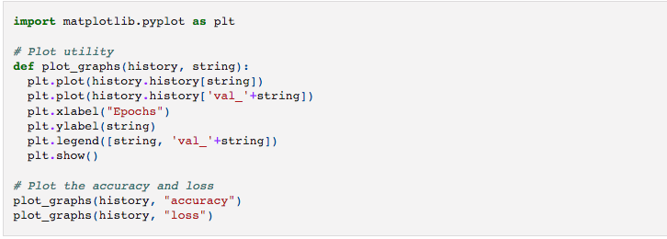
Visualize the Results
Classifier for the Sarcasm dataset
8
Notes:
8

Slide 9
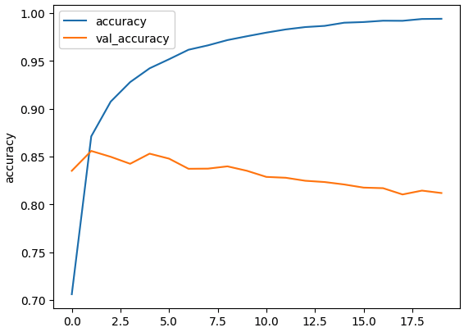

Visualize the Results
Give your opinion about this result ?
Classifier for the Sarcasm dataset
9
Notes:
overfiting
9

Slide 10
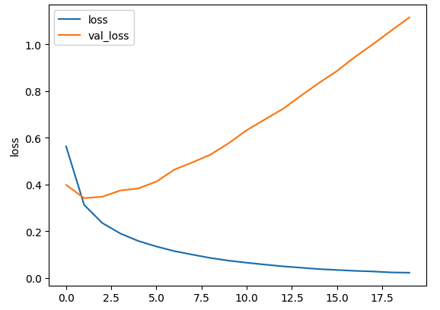
Visualize the Results
Give your opinion about this result ?
Classifier for the Sarcasm dataset
10
Notes:
overfiting
10

Slide 11
Summary
Process the Sarcasm dataset
Build a classifier for the sarcasm dataset
Classifier for the Sarcasm dataset
11

Slide 12
Q & A
Classifier for the Sarcasm dataset
12

